Slide 1

MGMT 22022 – Marketing Management
Lesson - 07
Place / Distribution
Lakna Ranasinghe
Lecturer (Temporary)
Department of Marketing Management
University of Kelaniya

Slide 2
What is Distribution?
Primarily all activities that relate to ensuring that products are made available for customers to buy in the
right place,
right quantity,
right time and
right condition.
include selecting a channel of distribution, physical distribution such as storage, loading, transportation, unloading, transit storage, breaking bulk packs

Slide 3
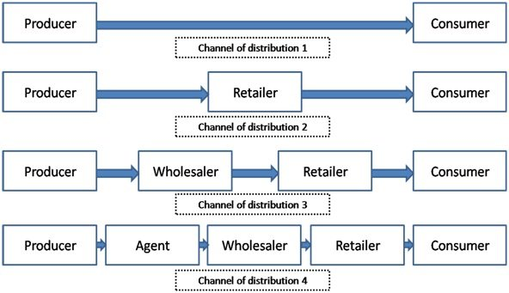
Different Distribution Channels and Members

Slide 4
Intermediaries
Organizations use intermediaries for distribution.
Importance of intermediaries
Lack of financial resources
Lack of necessary skills to perform distribution activities
To reduce costs and improve distribution efficiency
For distribution
More access to the market than producers
Offers the firm more than it can achieve on its own

Slide 5
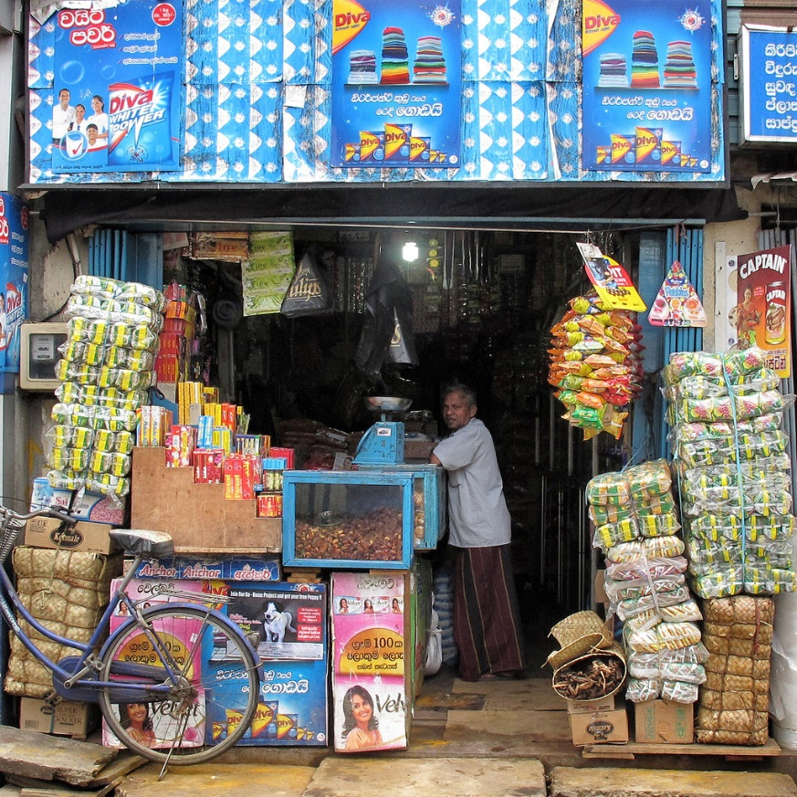
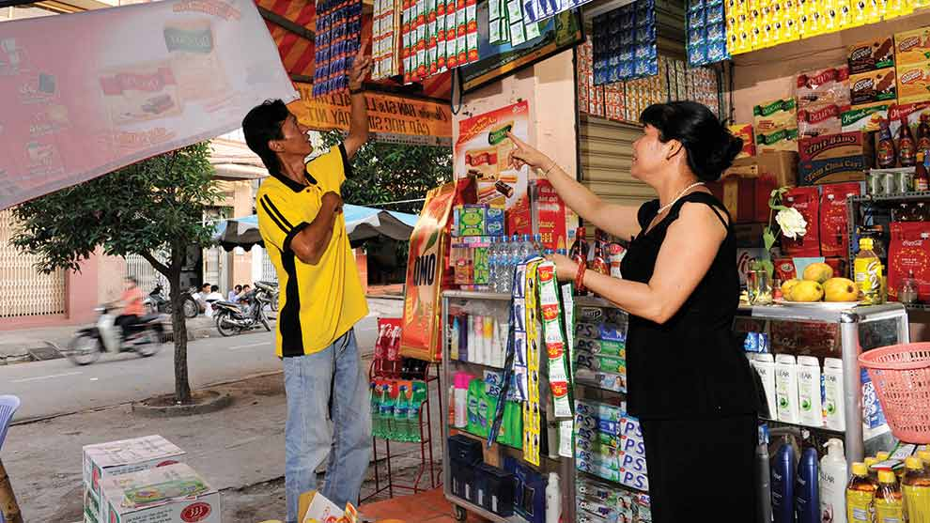
Functions of Intermediaries
Information
Storage
Promotion
Order Taking
Credit Exposure and Payment Collection
After Sales Service
Negotiation
Financing
Risk taking

Slide 6



Distribution Strategies
Intensive Distribution:
Distributing the product through all responsible and suitable wholesalers or retailers
Selective Distribution:
The manufacturer is selectively appointing intermediaries to carry the products
Exclusive Distribution:
The goods are sold through a very limited number of intermediaries

Slide 7
THANK YOU

